Slide 1
Virtual Environment Development
23rd Mar.

Slide 2
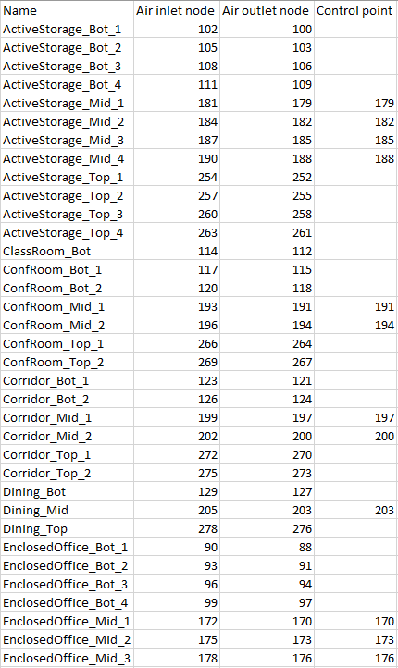
DOE Ref. Bldg
Goal: Middle level
AHU | Number of terminals | Zone type
Bot level | 23
Mid level | 21 | Active Storage (4), Conference room (2), Corridor (2), Dining (1), Enclosed Office (3), Lobby (1), Mechanical (1), Open Office (4), Restroom (1), Stair (2)
Top level | 22

Slide 3
Control variables
Variables to be controlled: 1 + 21*2 = 43
EnergyPlusToFMU has a constraint of 32 communication channel
 | Control variable | Node | Object in EnergyPlus
AHU | Supply air temperature | 149 | SetpointManager:Scheduled
Air terminal | Supply air temperature; Mass flow rate | 179, 182, 185, 188 … | AirTerminal:SingleDuct:UserDefined Actuator: Primary Air Connection - inlet mass flow rate Actuator: Primary Air Connection – outlet mass flow rate Actuator: Primary Air Connection – outlet temperature

Slide 4
The problem
In Han’s simulation, we use coil:heating:electric for reheat
No heating water plant and loop in Han’s simulation
Airterminal:singleduct:userdefined does not have the option of coil:heating:electric

Slide 5
Solution 1
Use Airterminal:singleduct:userdefined to set the supply mass flow rate and supply air temperature
Add heating water loop and boiler
Pros
More straightforward, benefit publication and open source the code
Cons
More difficult to implement
Redo Han’s simulation
Other ways to generate the heating water loop and boiler?

Slide 6
Solution 2
Use Airterminal:singleduct:uncontrolled to set the mass flow rate
Use equipment schedule to set the reheat
Pros
Consistent to Han’s simulation
Easy to implement
Cons
Not straightforward

